Slide 1
SOPA, PIPA, & OPEN:
What’s the Big Deal?
Chris Sweet
Technology and Pedagogy: Possibilities and Challenges
January, 28
Illinois Wesleyan University

Slide 2
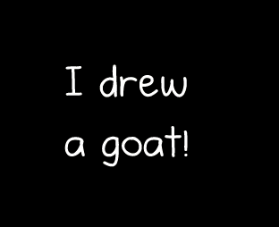

http://theoatmeal.com/sopa

Slide 3
SOPA, PIPA and OPEN are all current pieces of legislation that are proposing further regulations for copyright and online piracy
The legislation that currently regulates copyright is the Copyright Act of 1976 and the Digital Millennium Copyright Act (2000)

Slide 4
SOPA
SOPA = Stop Online Piracy Act
Introduced Oct. 26, 2011 by Representative Lamar Smith (Texas-R)
Would give content producers the power to have any website taken down if they think the site is “pirating” their work.
Requires ad networks, search engines, ISPs to cut off services to offending site.
No due process required

Slide 5
PIPA
PIPA = Preventing Real Online Threats to Economic Creativity and Theft of Intellectual Property Act of 2011
Introduced May 12, 2011 by Senator Patrick Leahy (Vermont-D)
DOJ files case in court resulting in blocking access to and cutting revenue sources for offending sites.
Encourages ad networks and payment processors to cut off services

Slide 6
OPEN
OPEN= Online Protection and Enforcement of Digital Trade Act
Introduced Dec. 17, 2011 by Senator Wyden (Oregon-D)
The OPEN Act would allow copyright holders to file complaints about copyright infringement at foreign websites with the U.S. International Trade Commission, which would investigate the complaints and decide whether U.S. payment processors and online advertising networks should be required to cut off funding.

Slide 7
For
Time Warner
News Corp.
Motion Picture Association of America
Recording Industry Association of America
US Chamber of Commerce
Against
Ebay
Google
Facebook
Twitter
Wikipedia
Craigslist

Slide 8
General Criticisms
Laurence Tribe, a Harvard law professor has argued that SOPA is unconstitutional because, if enacted, "an entire Web site containing tens of thousands of pages could be targeted if only a single page were accused of infringement."
Jimmy Wales Founder of Wikipedia: “The issue here is that this law is very badly written, very broadly overreaching and, in at least the Senate version, would include the creation of a DNS (domain name system) blocking regime that’s technically identical to the one that’s used by China. I don’t think that’s the right way the U.S. needs to go in taking a leadership role on the Internet.”

Slide 9
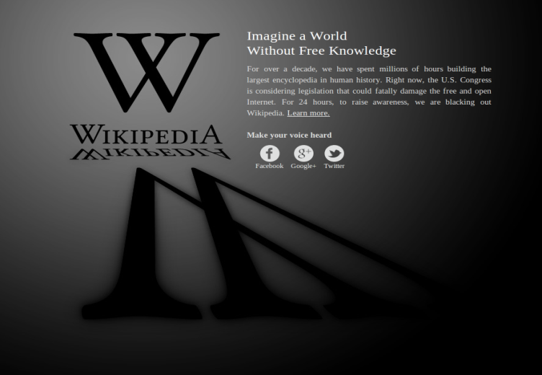


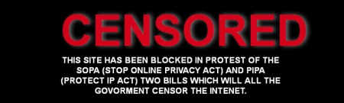
“SOPA Strike”
January 18
Largest online protest in history
More than 7000 sites!

Slide 10
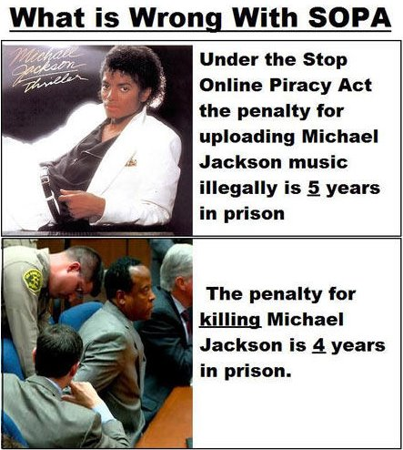
Potential implications for teaching faculty, instructional technologists and students

Slide 11
Academia Responds
Mellonie Fullick on the University Affairs Website:
“We need to pay attention to the changing information infrastructure (its physical, legal, and political economic aspects), since the changes made today can and will affect our capacities as researchers and teachers in the future.”
http://www.universityaffairs.ca/speculative-diction/access-denied-considering-sopa-higher-ed/

Slide 12
Academia Responds
Nov. 15, 2011. Open letter to the house of representatives from more than 100 law professors: “In sum, SOPA is a dangerous bill. It threatens the most vibrant sector of our economy – Internet commerce. It is directly at odds with the United States’ foreign policy of Internet openness, a fact that repressive regimes will seize upon to justify their censorship of the Internet. And it violates the First Amendment.”
SOPA strike: Syracuse I-School, Association for Computers and the Humanities and MIT Admissions all went dark!

Slide 13
General Implications
Universities would be exposed to increased copyright liability
Erodes 1st Amendment free speech rights and intellectual freedom
Faculty that upload any copyrighted content to an open class webpage would be “willfully infringing” upon this law
We’re in the middle of a great teachable moment regarding all of these issues.

Slide 14
Current Status
January 14 White House Statement:
“While we believe that online piracy by foreign websites is a serious problem that requires a serious legislative response, we will not support legislation that reduces freedom of expression, increases cybersecurity risk, or undermines the dynamic, innovative global Internet.”
http://www.whitehouse.gov/blog/2012/01/14/obama-administration-responds-we-people-petitions-sopa-and-online-piracy

Slide 15
Current status
PIPA- January 20
Senate Majority Leader Harry Reid: “In light of recent events, I have decided to postpone Tuesday’s vote on the PROTECT I.P. Act.”
SOPA- January 20
Representative Lamar Smith: “I have heard from the critics and I take seriously their concerns regarding proposed legislation to address the problem of online piracy. It is clear that we need to revisit the approach on how best to address the problem of foreign thieves that steal and sell American inventions and products.”

Slide 16
What about ACTA?
ACTA= Anti-Counterfeiting Trade Agreement
Signed by the European Commission on January 26th.
Signed Oct. 1, 2011

