Slide 1
Towards an Information Literacy Continuum: examining the high school to college research transition
Chris Sweet- Illinois Wesleyan University
Dana Convery- Prairie Central High School
Amanda Pilgrim- Illinois Wesleyan University
Information Literacy Summit
Illinois State University
4/20/10

Slide 2
Information Literacy Defined!

Slide 3
“What we’ve got here is failure to communicate”
Communication failure between:
  College Librarians and School Librarians
  Librarians and Teaching Faculty
  Librarians and Students
  Various professional associations
Our presentation/discussion today:
  Chris- academic library viewpoint
  Dana- high school teacher viewpoint
  Amanda- student viewpoint

Slide 4
What information literacy shortcomings do you see among your students?

Slide 5
ERIAL- Ethnographic Research in Illinois Academic Libraries
What are some of the things we learned about our students?
  They don’t know what a librarian is or does
  Many struggle to read a citation
  Many cannot use a call number to locate a book on the shelf
  Many have little research experience beyond Google
  To get help with research they will ask: their friends, their instructors, their parents and maybe a librarian
  Almost complete lack of evaluation/critical thinking about sources
In my experience this holds true at IWU and Heartland. Why?

Slide 6
The Disconnect
We’ve mentioned the communication issues
Lack of professional librarians at the H.S. level
Lack of resources at the H.S. level (dated book collections, little or no database access)
Dated research abilities among all teaching faculty (this is passed on to students)
If it got me a “A” in high school…..
Research and Info Lit just not seen as high priority skills
Lack of universally agreed upon research/info lit standards

Slide 7
Standards
Most current standards do address information literacy in some way, shape, or form. How much priority or emphasis is placed on info lit varies greatly.
What standards are out there?
  Illinois State Board of Education Learning Standards
  Partnership for 21st Century Skills
  Standards for the 21st Century Learner (AASL)
  ACRL Information Literacy Competency Standards

Slide 8
Solutions?
Academic librarians need to be involved in undergrad and graduate teacher education programs.
Academic librarians need to do more outreach to both school librarians and H.S. teachers.
School librarians need to make a stronger case for info lit skills to administrators and teaching faculty
Collaborative programming
One agreed upon set of standards that progress from K through undergrad?
Better communication on these issues among professional associations

Slide 9
Resources
“BluePrint for Collaboration” Joint project of ACRL/AASL
Library Instruction Roundtable: Transitions to College Committee
“Climbing out of the ‘Ivory Tower’” Article
Elements of Library Research: What Every Student Needs to Know. Mary George.

Slide 10
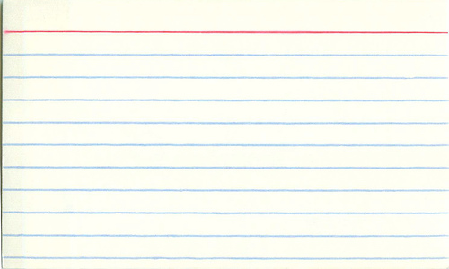
Teaching Research
Assignment
Notecard Format:
Students choose a topic to research and use FirstSearch to find articles
Students use notecards to take notes over researched material
Students create an outline, focusing topic
Students create a Works Cited Page using EasyBib.com
Guideline
Author/Title
Paraphrase/Summary
Page #

Slide 11
Limitations in Research Assignment
Resources
Library “Dumping Ground”
Few books relevant to student topics in library
Not enough time for inter-library loan with block schedule
Few online databases available to school
Databases not shown to teachers; therefore, no student access
Library used for displaced students, i.e. study hall
Saturday detentions are served in library
Students kicked out of class go to the library
General Consensus: No one wants to be in the library! ☹

Slide 12
Improvement Goals
Align departments to the 21st Century Literacy Skills
Collaboration between librarian and teachers to teach common set of skills
Re-invent the library atmosphere to make students want to be there
Develop “common knowledge” language among departments, so research skills are uniform
Opportunities for co-teaching with a librarian to optimize teaching of research skills

