Slide 1
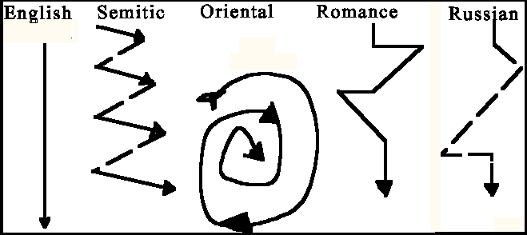
Intellectual Property and Attribution in a Cross-Cultural Context: Understanding International Students' Attitudes Towards Citation and Plagiarism
Chris Sweet
Illinois Wesleyan University
Information Literacy Librarian

Slide 2
If you want to write a poem you must first copy three hundred good poems.
-Chinese Proverb

Slide 3
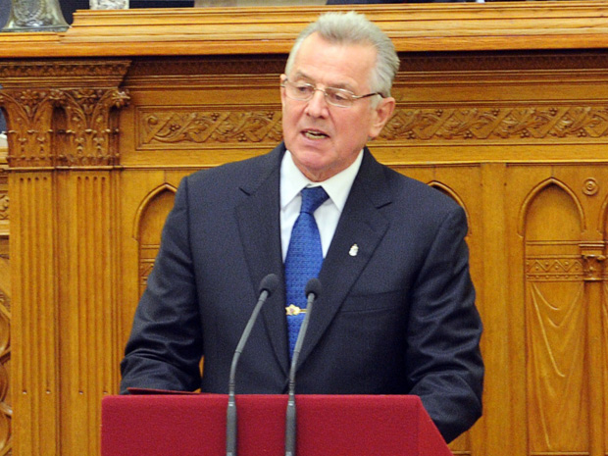
Hungarian President Resigns Amid Plagiarism Scandal
April, 2012
http://nationalpostnews.files.wordpress.com/2012/04/schmitt.jpg?w=620
Notes:
The president of Hungary, Pal Schmitt, resigned from his largely ceremonial post on Monday amid a storm of criticism over what he called “unfounded allegations” of plagiarism in his 1992 doctoral thesis.
http://www.nytimes.com/2012/04/03/world/europe/hungarian-president-pal-schmitt-resigns-amid-plagiarism-scandal.html

Slide 4

Vietnamese Physicist Retracts 7 Papers due to Plagiarism
June 3rd
http://www.tuoitrenews.vn/cmlink/tuoitrenews/education/education-news/researcher-plagiarizing-7-papers-blames-instructor-1.74561

Slide 5
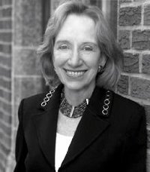
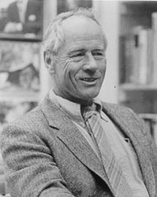
Not just an International Problem!

Slide 6
International Students: The Big Picture
700,000 International Students in 2011
32% Increase since 2000
Top Five Countries of Origin
  China
  India
  South Korea
  Canada
  Taiwan
  http://www.iie.org/Research-and-Publications/~/media/Files/Corporate/Open-Doors/Fast-Facts/Fast%20Facts%202011.ashx

Slide 7
Plagiarism and College Students
84% of college students believe they need to cheat to get ahead
90% believe they won’t get caught
  1999 US World and News Report Survey
A University of Minnesota study found that “85% of all scholastic dishonesty cases related to plagiarism involved non-native speakers of English”.
  Mundava & Chaudhuri, C&RL News, 2007

Slide 8
Culture?
Culture: “A learned meaning system that consists of patterns of traditions, beliefs, values, norms, meanings and symbols that are passed on from one generation to the next and are shared to varying degrees by interacting members of a community.
  (Ting-Toomey and Chung)

Slide 9
Robert Kaplan- “Cultural Thought Patterns in Inter-Cultural Education” (1966)
Notes:
Seminal article, but oversimplified and potentially ethnocentric.

Slide 10
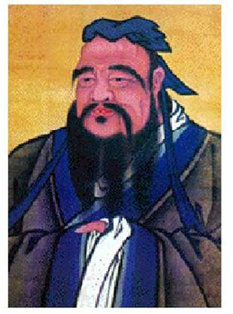

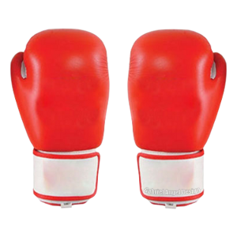
Another Way to Think About It!

Slide 11
Universalism vs. Particularism
Universalism | Particularism
Focus on rules | Focus on relationships
Consistency of rules | Flexibility of rules
One truth or reality | Multiple perspectives of reality
“Get down to business” | “Get to know you”
What countries do you think valued universalism the most?
The least?

Slide 12
Value Universalism
Switzerland 97 | Japan 68
U.S.A. 93 | Mexico 64
Australia 91 | India 54
Netherlands 90 | China 47
Germany 87 | Russia 44
Poland 74 | Korea 37
France 73 | Nepal 36
Adapted from Fons Trompenaars and Charles Hamden-Turner’s research (see www.7d-culture.nl/index1.html)

Slide 13
Individualism vs. Collectivism
Individualism | Collectivism
Identity as individual- “I” | Identity in membership- “we”
Value independence | Value interdependence
Freedom | Stability
Individual initiatives | Consultation and consensus
Heroes or champions | Whole is credited- no favorites
The following chart is adapted from Geert Hofstede’s website at www.geert-hofstede.com/ It illustrates the degree to which individualism is valued in different cultures.
U.S. 91 | India 48 | China 20
Australia 90 | Japan 46 | West Africa 20
UK 89 | Russia 39 | Bangladesh 20
Sweden 71 | Arab World 38 | South Korea 18
Germany 67 | Brazil 38 | Pakistan 14
Austria 55 | Mexico30 | Ecuador 8

Slide 14
Ouyang Huhua, Professor of English at Guandong University of Foreign Studies:
“The notion of plagiarism is alien to Chinese culture, where there is no individual claim, no ownership over intellectual property, and it is hard for Chinese students to conceptualize the idea.
http://www.timeshighereducation.co.uk/story.asp?storycode=401564

Slide 15
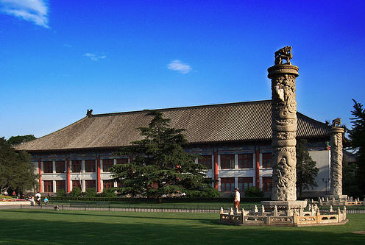
Peking University’s 2002 rule on plagiarism was the first for a Chinese University.

Slide 16
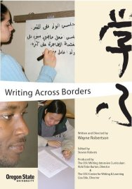
Writing Across Borders
3 Year Documentary from Oregon State’s Center for Writing
How does culture play out in writing, and how are our expectations shaped by cultural preferences?
How do we assess international student writing?
What kinds of teaching and testing practices disadvantage international students and which help them improve as writers?

Slide 17
Why do international students plagiarize?
Unintentional
  Cultural reasons
  Unfamiliar with the U.S. academic citation models
  Variations in what is considered “common knowledge”
Intentional
  Coping strategy
  Lack of language and writing skills
  Think they can get away with it

Slide 18
International Students and Plagiarism Detection Software
“the inappropriate use of electronic plagiarism detection systems (such as Turnitin) could lead to the unfair and unjust construction of international students as plagiarists.”
  Introna and Hayes, 2007

Slide 19
International Students and Plagiarism Prevention
What Faculty can do:
Create assignments that would be difficult to plagiarize
  http://cgi.stanford.edu/~dept-ctl/tomprof/posting.php?ID=1001
Simple awareness of different cultural attitudes towards plagiarism
Encourage class discussion about plagiarism
Make sure international students understand what constitutes plagiarism (course syllabus and assignment guidelines)
Require multiple drafts to catch problems early
General guidelines for plagiarism prevention: http://www.plagiarism.org/resources/documentation/plagiarism/learning/preventing_plagiarism_instructor.doc

Slide 20
What libraries can do
International Student Workshops
  Avoiding plagiarism (philosophy as well as practice)
  American Citation Systems
  Library research skills
Faculty Workshops
Create (or link to) plagiarism tutorials
Core Cultural Values and Culture Mapping activity: http://www.carla.umn.edu/maxsa/documents/Cultural%20Values_MAXSA_IG.pdf

Slide 21
Questions about the presentation?
Thoughts or reactions regarding the Culture Mapping Activity?
Chris Sweet
Illinois Wesleyan University
csweet@iwu.edu

