Slide 1

The Failure of Skepticism: Rethinking Information Literacy and Political Polarization in a Post-Truth Era
ACRL Student Learning and Information Literacy Committee
Chris Sweet, Information Literacy Librarian, Illinois Wesleyan University
Troy Swanson, Library Department Chair, Moraine Valley Community College
Jeremy L. Shermak, Assistant instructor in the School of Journalism
and Moody College of Communication Doctoral Fellow at The University of Texas at Austin.
2/15/2019

Slide 2

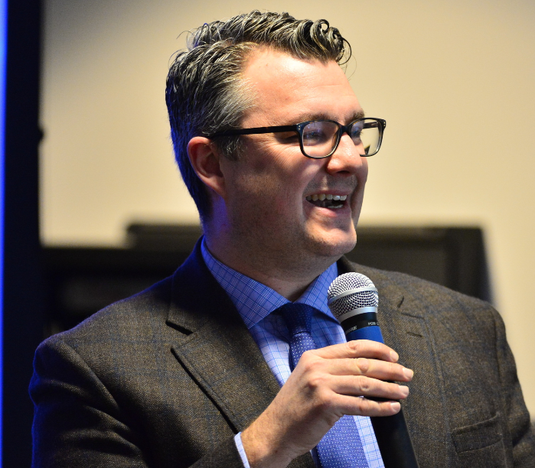

Quick Intros
Forthcoming from ACRL:
Libraries Promoting Reflective Dialogue in a Time of Political Polarization
Our chapter:
“You Shall Listen to All Sides and Filter Them from Yourself”: Information Literacy and ‘Post-Truth’ Skepticism
Chris Sweet
Troy Swanson
Jeremy Shermak

Slide 3
Who wrote it?
You shall no longer take things at second or third hand nor look through the
eyes of the dead nor feed on the spectres in books,
You shall not look through my eyes either, nor take things from me,
You shall listen to all sides and filter them from yourself.

Slide 4
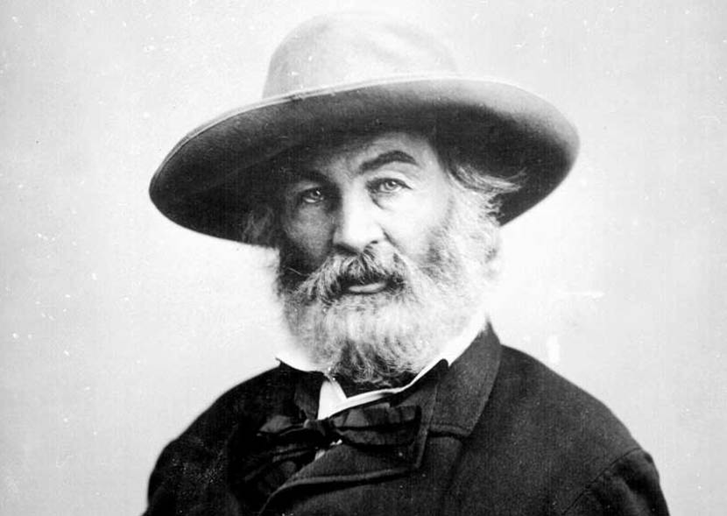
You shall no longer take things at second or third hand nor look through the
eyes of the dead nor feed on the spectres in books,
You shall not look through my eyes either, nor take things from me,
You shall listen to all sides and filter them from yourself.
Walt Whitman, Song of Myself, 1855

Slide 5
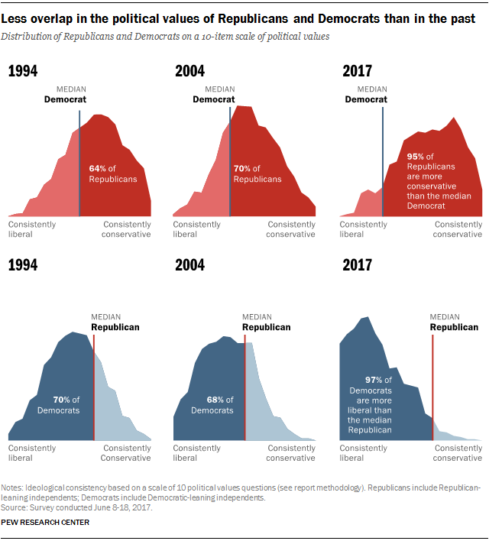
“In Polarized Era, Fewer Americans Hold a Mix of Conservative and Liberal views”
Pew Research Center
https://pewrsr.ch/2HRhg4D

Slide 6
What do we mean by failure of skepticism?
Setting aside philosophical skepticism
Merriam Webster definition: “An attitude of doubt or a disposition to incredulity either in general or toward a particular object.”
Speaking broadly, in this new post-truth era, skepticism is failing at both extremes: many of us are not skeptical enough of information often amplified by social media while at the other extreme rampant skepticism of all information from ideologically divergent sources actually allows fake news to thrive.
We as a profession need to rethink how we teach skepticism in the modern information landscape. Is the skepticism that information literacy instructors have been preaching causing individuals to retreat to their “corners” of ideologies? Have we become so overwhelmed and partisan that we are questioning the very truth of indisputable facts?

Slide 7
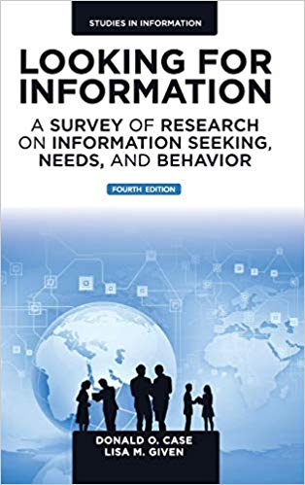
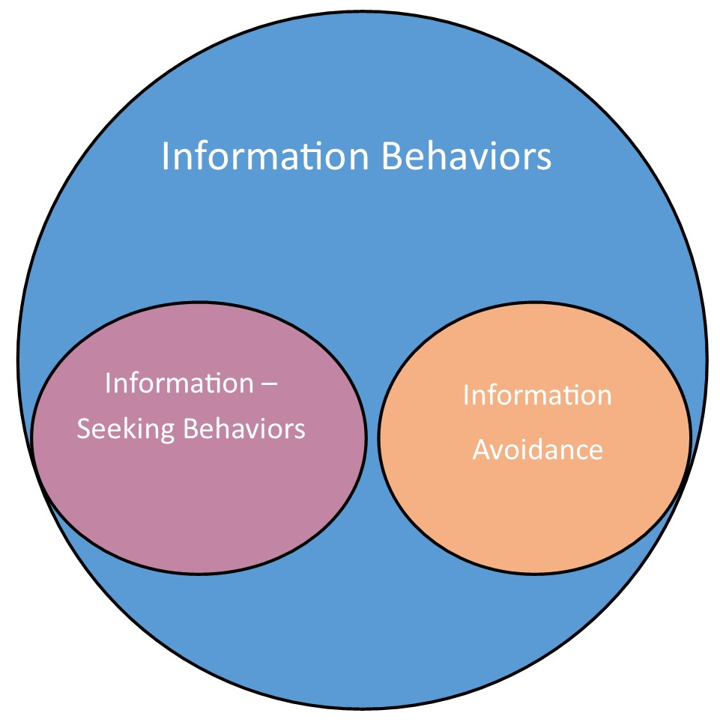
Information Behaviors
Information Behaviors “encompass information seeking as well as the totality of other unintentional or serendipitous behaviors . . . as well as purposive behaviors that do not involve seeking, such as actively avoiding information.”
Information-Seeking Behaviors are conscious, intentional efforts to acquire information that fulfills an information need.
Information Avoidance Humans are predisposed to avoid information that conflicts with their worldviews. This “selective exposure” or “confirmation bias” is even more pronounced when dealing with political ideologies and new information. Avoiding information is a common information behavior, but it is not an information-seeking behavior.
Donald O. Case and Lisa M. Given, Looking for Information, 4th ed. (Bingley, UK: Emerald, 2000), 6.

Slide 8
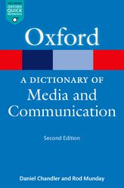
Selective Exposure: A tendency for people both consciously and unconsciously to seek out material that supports their existing attitudes and beliefs and to actively avoid material that challenges their views. More broadly, audiences may seek congruence with their predispositions, including any aspect of their identity.
Selective Avoidance: the motivated avoidance of messages discrepant with one’s beliefs.
Confirmation Bias: A tendency to seek and attend to information that confirms the individual’s beliefs or expectations and to discount that which does not.
Chandler, D., & Munday, R. (Ed.), A Dictionary of Media and Communication. : Oxford University Press, 2016.

Slide 9

ACRL Framework
Framework for Information Literacy for Higher Education (2016).
Frame: Authority is Constructed and Contextual. “Information resources reflect their creators’ expertise and credibility, and are evaluated based on the information need and the context in which the information will be used.”
The Framework further elaborates: “Authority is constructed in that various communities may recognize different types of authority.”
Uh-oh.

Slide 10
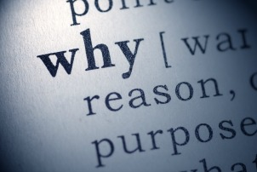
Why do we make decisions?

Slide 11
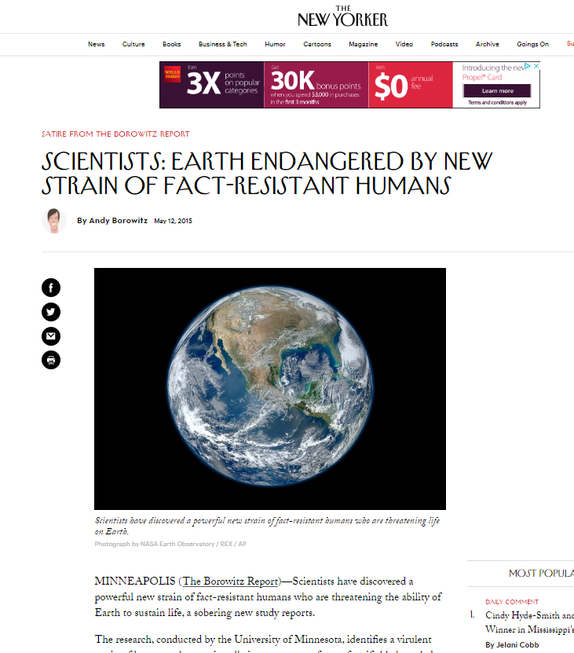
Pop Quiz
Get ready
4 questions

Slide 12
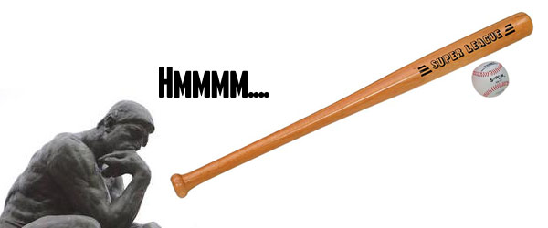
Question
“A bat and a ball cost $1.10 in total.
The bat costs $1.00 more than the ball.
How much does the ball cost?”

Slide 13
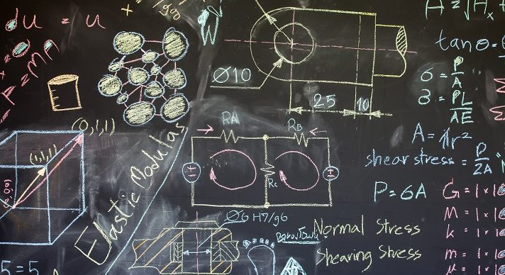
Another Question
Highly intelligent women often marry less intelligent partners.
Why?

Slide 14
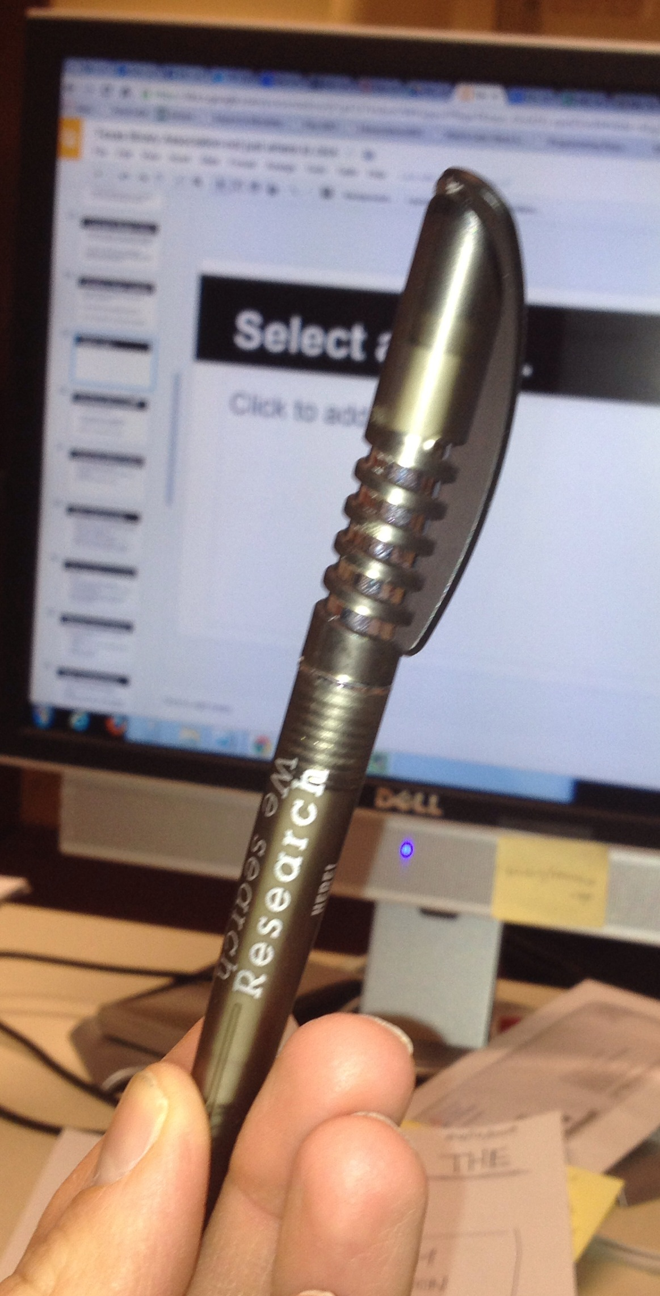
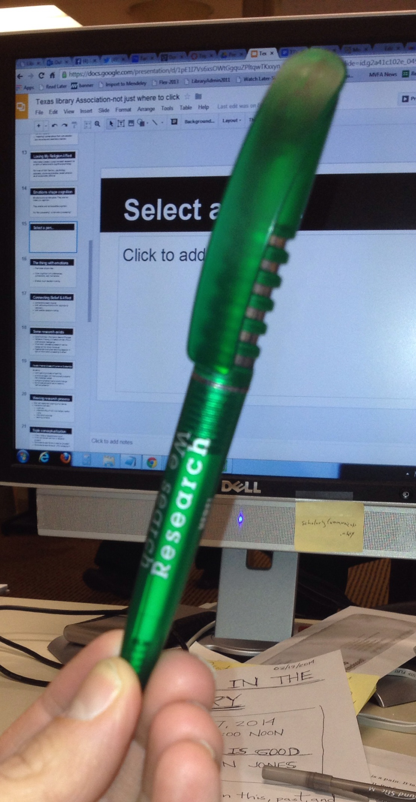
Select a Pen: What pen would you choose?

Slide 15
Is this ok?
"Julie and Mark are brother and sister. They are traveling together in France on summer vacation from college. One night they are staying alone in a cabin near the beach. They decide that it would be interesting and fun if they tried making love. At the very least, it would be a new experience for each of them. Julie was already taking birth control pills, but Mark uses a condom too, just to be safe. They both enjoy making love, but they decide never to do it again. They keep that night as a special secret, which makes them feel even closer to each other. What do you think about that? Was it ok for them to make love?"
Haidt, J. (2001). The emotional dog and its rational tail: A social intuitionist approach to moral judgment. Psychological Review, 108, 814–834.

Slide 16
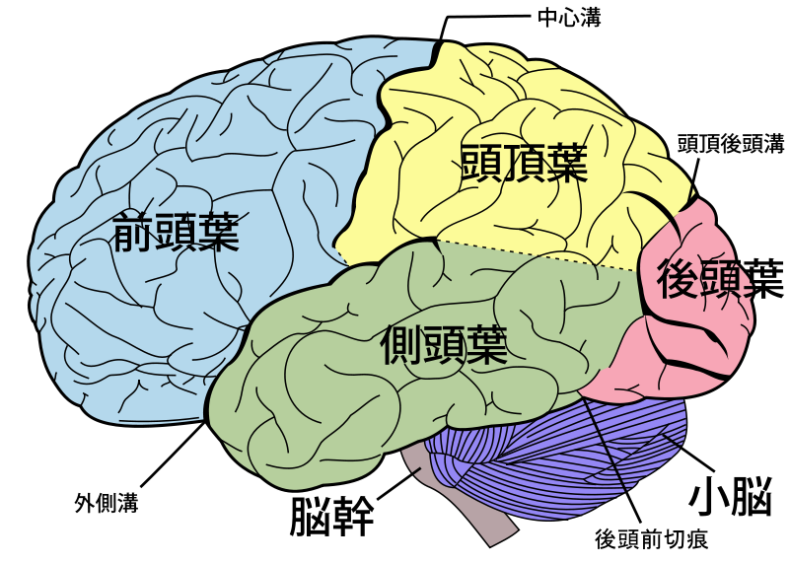
Your Brain
Brains are NOT data processing machines.
Reason is a social process.
Brains are lazy. (Use heuristics.)
Emotions are part of reasoning.
Most decisions come from our gut. Then, we make up reasons later.

Slide 17
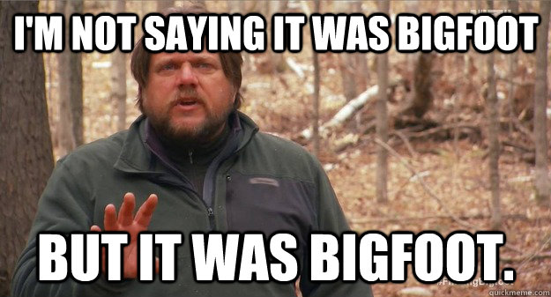
Evolutionary Source of Reason & Reasoning
Group Level:
Evolutionary tool for groups with multiple purposes
Decision-making
Group cohesion
Individual Level:
Make up your own reasons
Evaluate reasons of others

Slide 18
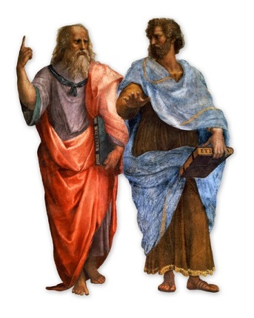
Mercier and Sperber
“The main role of logic in reasoning, we suggest, may well be a rhetorical one: logic helps simplify and schematize intuitive arguments, highlighting and often exaggerating their force.”
Hugo Mercier & Dan Sperber, The Enigma of Reason (2017), p. 7.

Slide 19

Your Beliefs are Relative to:
Your identity
Your experience
Your existing beliefs
Information is personal.

Slide 20
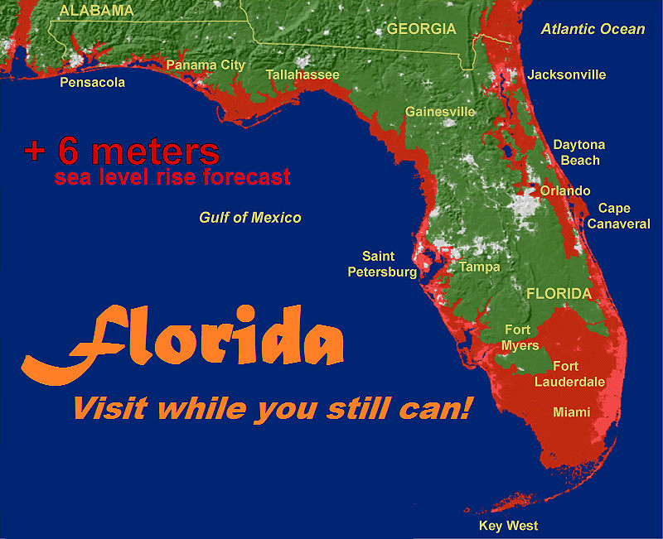
Topics have vectors
Well-informed Agreers
Agreers
Agnostics
Disagreers
Well-informed Disagreers

Slide 21

Mechanics of “Skepticism”
Confirmation bias
  Defensive avoidance
  Selective exposure

Slide 22
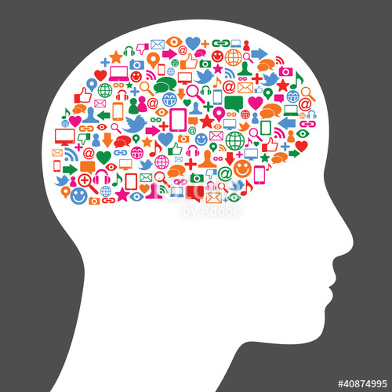
Landscape for Skepticism: Today’s Media
“Anyone who wants to understand today’s news environment faces a challenge: How to discern the nuances of digital news habits when Americans’ attention spans are fractured, human memory is naturally limited and news comes at them every which way.”
Pew Research Center

Slide 23

“Stumbling upon” news
“Stumbling upon” news = our incidental exposure to news (e.g. social media, airport televisions, etc.)
Today’s news consumers are more likely to stumble upon news while not in “information-seeking mode” - e.g. while playing Words with Friends on Facebook
Consequences:
  Those stumbling upon news were less likely to engage politically
  Stumbling upon like-minded partisan news reinforced selective avoidance
Kim, Y., Chen, H. T., & De Zúñiga, H. G. (2013)

Slide 24
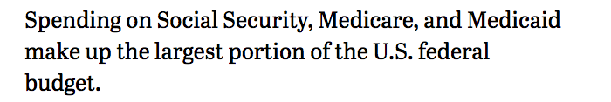
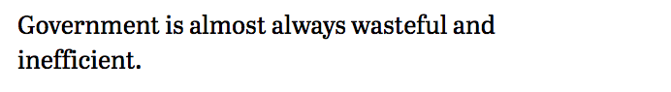
Fact or opinion? Pew Research Quiz
Source: Pew Research Center, http://www.pewresearch.org/quiz/news-statements-quiz/

Slide 25
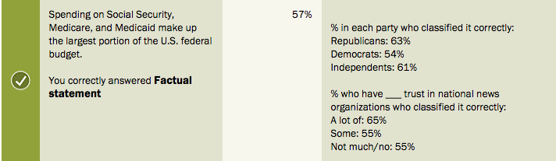
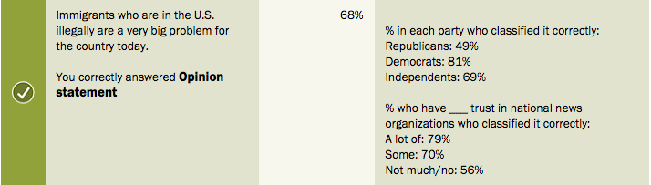
Fact or Opinion - Some results from Pew
Source: Pew Research Center, http://www.pewresearch.org/quiz/news-statements-quiz/

Slide 26
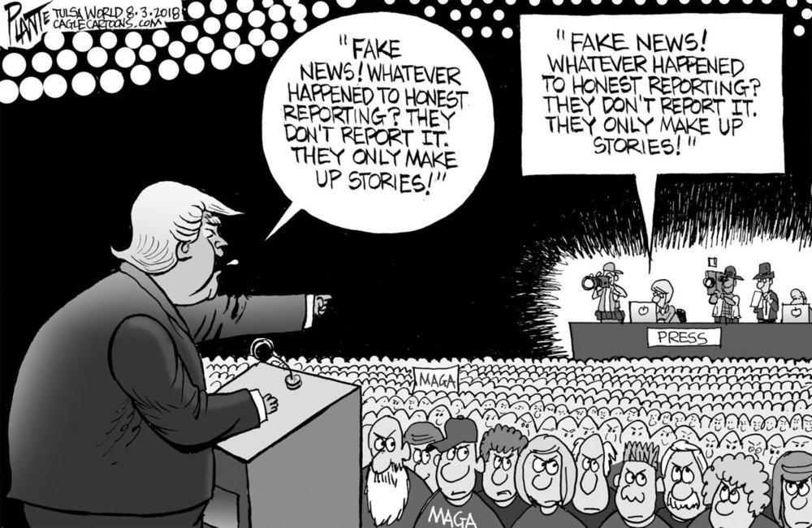
Discerning Fact vs. Opinion
Tsunami of information - specifically news - also challenges discerning fact from opinion
Mix of hard news and opinion is more convoluted than ever
Pew Research Study (2018) - Fact vs. Opinion Test:
  Only 26% of Americans were able to correctly identify facts
  Only 35 percent were able to identify opinion
  Differed along political party lines
Source: Pew Research Center, http://www.pewresearch.org/quiz/news-statements-quiz/

Slide 27
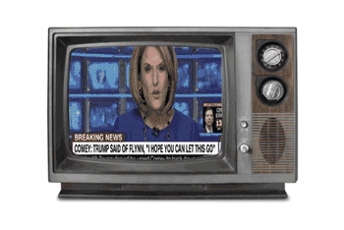
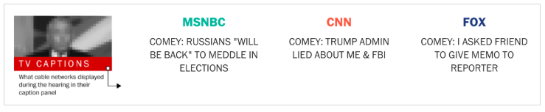
“A minefield of confirmatory thought”
Increasingly partisan news sources reinforce echo chambers
Cable news networks’ ‘Lower Thirds’ at a single moment during
2017 James Comey Senate Testimony
Source: https://www.washingtonpost.com/graphics/2017/politics/comey-hearing-chyrons/

Slide 28

Confirmatory Thought at work
Initial outrage → Complete video surfaces → More outrage
Why? What element “deneutralizes” this image?
Follow up is altered by confirmatory thought
Silence vs. outrage
NYT: “Sunday, Mr. Phillips clarified that it was he who had approached the crowd and that he had intervened because racial tensions — primarily between the white students and the black men — were ‘coming to a boiling point.’”
Source: https://www.nytimes.com/2019/01/20/us/nathan-phillips-covington.html

Slide 29
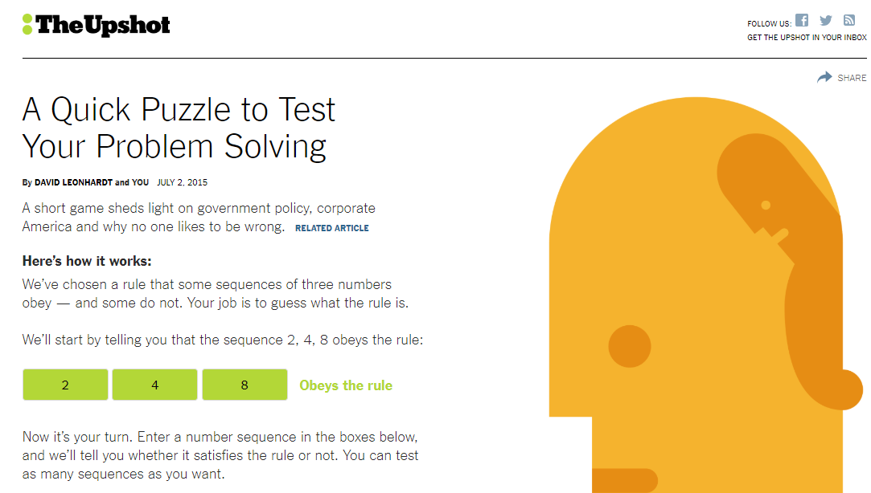
Practical Classroom Activities
Have students spend five minutes trying to discover the “Wason Rule”. The test provides a sequence of numbers, then allows students to propose additional sequences and tells them whether or not those sequences follow the rule. The Wason Rule is simply that the numbers in the sequence are increasing. Most people will assume that the rule is more complex. The Wason rule teaches confirmation bias in a very practical way.
David Leonhardt, “A Quick Puzzle to Test Your Problem Solving,” The Upshot, New York Times, July 2, 2015. https://www.nytimes.com/interactive/2015/07/03/upshot/a-quick-puzzle-to-test-your-problem-solving.html?_r=0)

Slide 30
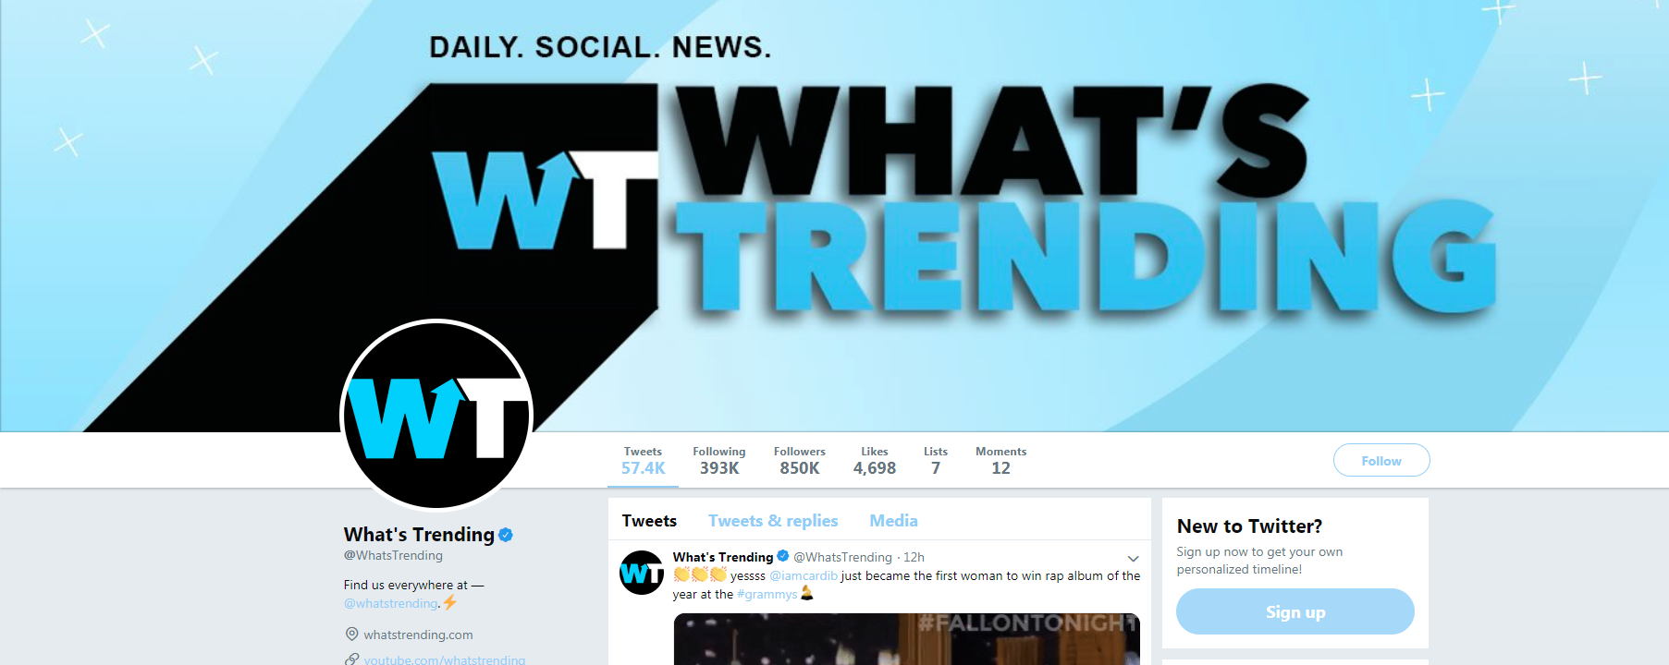
Read a summary of “The Spread of True and False News Online” (a major fake news study published by researchers at MIT). Then have students review trending topics on Twitter (https://twitter.com/whatstrending). Given the information about the types of news that people are predisposed to share, have the class discuss what can be learned from the stories that are trending that day. Do any of the trending stories meet the criteria of new and novel information (whether it is true or not)? From a psychological perspective, why is this problematic?
Soroush Vosoughi, Deb Roy, and Sinan Aral, “The Spread of True and False News Online,” Science 359, no. 6380 (March 2018): 1146–51.

Slide 31

The News Literacy Project and the Facebook Journalism Project combined forces to create Checkology (https://checkology.org/). This virtual classroom teaches students to “navigate the challenging information landscape by mastering the skills of news literacy.” Lessons help students identify fake news, interpret the First Amendment, identify logical fallacies, and learn about confirmation bias. Basic access to three lessons is free, with the option to purchase access to all the lessons.

Slide 32
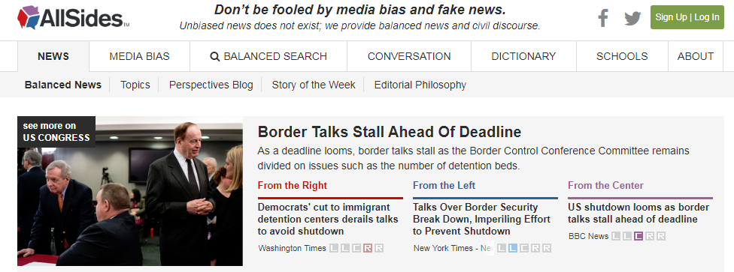
Give students Post-it Notes and have them write three to five news or information sources that they consume/follow regularly. On the board, draw a line across the center to represent the spectrum of partisan sources. Label “Left,” “Middle,” and “Right.” Have students place the Post-it Notes on the board in relation to what they perceive to be their political leaning. Once the notes are placed, direct the students to the website AllSides.com (https://www.allsides.com/unbiased-balanced-news), a crowdsourced, scholarly backed news service dedicated to presenting news from varying sources that categorizes news sources as Left, Center and Right. Once students find their sources on AllSides, have them return to the board and move—if necessary—their sources to where AllSides rates their partisanship. Once finished, discuss the exercise with the students by asking: How many had to move their sources? Were you surprised by the way AllSides rated your sources?

Slide 33
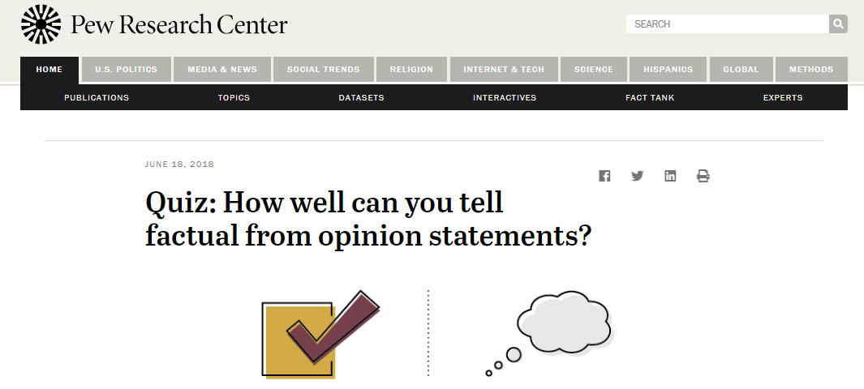
Instruct students to take Pew Research Center’s “Quiz: How Well Can You Tell Factual from Opinion Statements?” When they have finished, have students share their results in small groups or in a discussion forum. Reveal the national results from the study and compare them to the students’ results. The study suggests that most Americans struggle to differentiate fact from opinion in news content and that this is particularly true among partisans. It exemplifies some of the core issues exacerbating problematic skepticism, such as motivated reasoning. This can make students aware of their own biases and the mechanisms in play that trigger skepticism.
http://www.pewresearch.org/quiz/news-statements-quiz/

Slide 34
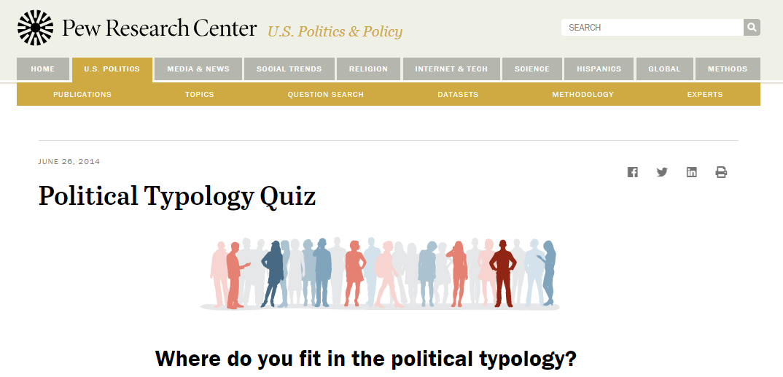
Encourage students to be reflective of their own perspectives by having them take the Implicit Association Test from Project Implicit, which measures attitudes and beliefs, or the Political Typology Test from Pew Research . These tests may be useful tools to help students to be more reflective on their own perspectives. Using them can be a step for students to recognize their own bias and reflect upon how it impacts their information choices.
Project Implicit: https://implicit.harvard.edu/implicit/takeatest.html
Political Typology Test: http://www.people-press.org/quiz/political-typology/

Slide 35
Some Conclusions
Information is personal!
Librarians need to enter into a robust professional dialogue about the connections between identity, skepticism, and reason.
Librarians must come to terms with the likelihood that knowledge does not exist in a meaningful way as a distinct thing separate from identity.
The DIKW hierarchy—data, information, knowledge, wisdom—that many of us learned in our introductory classes at graduate school does not connect with the empirical evidence in the psychology literature.

Slide 36
Some (More) Conclusions
Political polarization cannot be overcome with more and better sources. It will not be overcome with better logic because the inherent skepticism will defeat logic. Overcoming skepticism requires an environment of trust. Reason works best on a social basis when trust connects individuals. This is where ideas flourish. This is how skepticism falls away.
The Framework states that “Authority is constructed in that various communities may recognize different types of authority.” Noting that communities recognize different types of authority launches us into a skeptical abyss. There is a need for a knowledge or epistemological values statement. This statement should make explicit the values hidden within the Framework, namely the importance of dialogue, evidence, journalistic reporting, and intellectual curiosity, to name just a few possibilities. Librarians rightly shy away from dictating “truth” to the communities they serve. Traditionally, librarians have stayed safely neutral, providing information but not engaging in the debate.
Although the Framework muddies the waters, authorities (and authoritative information) exist.

Slide 37
Thanks!
Questions?
This spring: Libraries Promoting Reflective Dialogue in a Time of Political Polarization
Chris Sweet: csweet@iwu.edu
Troy Swanson: swanson@morainevalley.edu
Jeremy Shermak: shermakj@utexas.edu

