Slide 1
Nurturing Failure:
Creating a risk-tolerant library culture that embraces change and innovation
Chris Sweet
csweet@iwu.edu
Illinois Wesleyan University
ACRL/LLAMA Spring Virtual Institute
4/21/2010

Slide 2
Failure Video
Also available at: http://www.youtube.com/watch?v=Y6hz_s2XIAU&feature=related

Slide 3
Now that we’re warmed up, let’s try a few more of these.
Use the chat box to make your best guess as to who I am describing. The first right answer gets 10,000 points! (no cash value!)

Slide 4
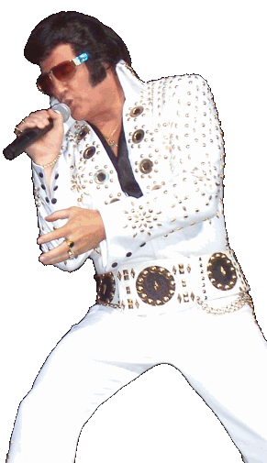
Fired from the Grand Ole Opry after only one performance and told by the manager, “You ain’t goin’ nowhere, son. Better get y’all job back drivin’ a truck.”

Slide 5

Got fired from a reporting job and was told, “You’re not fit for TV.”
Her biography is entitled: “I Don’t Believe in Failure.”

Slide 6

As a young college graduate this writer was an unemployed single parent living on welfare in a rat-infested apartment.
Her parents had hoped she would go to vocational school, instead she had studied classics.
She recently gave a Harvard commencement address entitled: The Fringe Benefits of Failure and the Importance of Imagination.

Slide 7
From JK Rowling’s commencement address:
“You might never fail on the scale I did, but some failure in life is inevitable. It is impossible to live without failing at something, unless you live so cautiously that you might as well not have lived at all – in which case, you fail by default.”
http://harvardmagazine.com/commencement/the-fringe-benefits-failure-the-importance-imagination

Slide 8
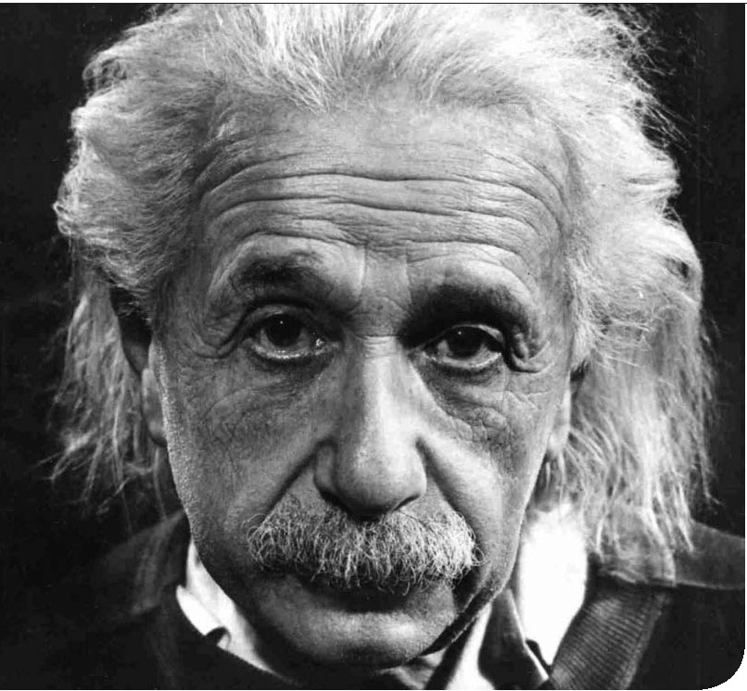
This scientist didn’t finish high school. He then failed the entrance exams to the Swiss Polytechnic Institute.

Slide 9
Presentation Overview
My background and research in this area
Concept of “Failing Forward”
Looking for answers outside the library box
  Athletics & Sports Psychology
  Successful companies
  Management Strategies
  Videogame culture
  Many other possibilities
Nurturing Failure
Safeguarding Success
Failure & Libraries

Slide 10
Can we agree on a couple points?
Libraries are changing rapidly
Useful, productive change does not come easy
Innovation is an essential element of change
In 2007 Toyota overtook GM in Global sales (we’ll get back to this)

Slide 11
The win-at-all-costs mentality is ingrained in our culture (but not all cultures).
Consider:
  Steroid use in Sports
  Insider Trading
  Student suicide rates
  Grade Inflation
  War?

Slide 12
Failing Forward
“I think the whole concept of success and failure needs to be re-thought. We’re such a success-oriented culture, but I think what we need is more failure. Improvements only happen when you try things differently.”
-Richard Farson, author of Whoever Makes the Most Mistakes Wins.
“Relying on conventional, outmoded ideas about success and failure stands in the way of your ability to innovate, compete, and stay ahead of the curve in a changing economy.” (Farson).

Slide 13
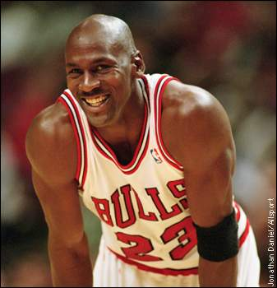
We need to redefine success and failure.
From 1926 to 1964 Babe Ruth held a lesser known record for most strikeouts (1,330).
“Self-handicapping is described as an action or choice which prevents a person from being responsible for failure (Kolditz & Arkin, 1982).” http://www.psychwiki.com/wiki/Self-handicapping
Self-handicapping is very prevalent in sports, but is also affects many other human endeavors.
“I’ve missed more than nine thousand shots in my career. I’ve lost almost 300 games. Twenty-six times I’ve been trusted to take the winning shot and missed. I’ve failed over and over and over again in my life. And that is why I succeed.” -Michael Jordan

Slide 14
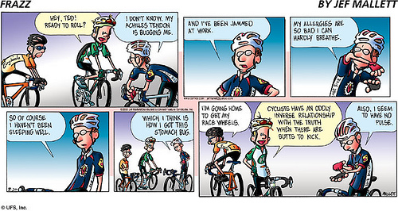
Self-Handicapping in Action!

Slide 15

Industry Examples
“The Toyota Way” guidelines are influenced by Buddhist principles.
Manage as if you “have no power”.
(taken from samurai teachings).
“Toyota’s culture readily accepts that the greatest companies are also flawed companies that routinely make mistakes. At Toyota, imperfections are not overlooked or avoided, but treated with reverence and attention and openly acknowledged as highly important”
How Toyota Became #1

Slide 16

“…the culture at Ford”, said top executive Mark Fields, “has been one of equating a request for help with weakness. Directives come down from on-high, and lower-level employees are simply expected to do their jobs, no questions asked.”

Slide 17
Is there an 800 lb Gorilla in the (chat) room?
What about all those accelerator and braking problems?
In 2003 Toyota recalled 79% fewer vehicles in the U.S. than Ford and 92% fewer than Chrysler. (Toyota Way, p.5) So what happened???
CEO Akio Toyoda: “I would like to discuss what caused the recall issues we are facing now. Toyota has, for the past few years, been expanding its business rapidly. Quite frankly, I fear the pace at which we have grown may have been too quick. I would like to point out here that Toyota's priority has traditionally been the following: First; Safety, Second; Quality, and Third; Volume. These priorities became confused, and we were not able to stop, think, and make improvements as much as we were able to before …” http://www.guardian.co.uk/business/2010/feb/24/akio-toyoda-statement-to-congress

Slide 18
Success Breeds Complacency
GM’s manufacturing model worked well for so long, why change it? Well………
Success also inhibits innovation (we NEED innovation!)
We learn more from our mistakes than our successes.

Slide 19

Post-It note story!
3M estimates that 60% of it’s formal product launches fail!
11th Commandment: “Thou shalt not kill a new product idea”
30% off all new products should not have existed in any form 4 years earlier!
Carefully cultivated culture that is highly tolerant of risk and failure

Slide 20
Six Sigma vs 3M!
Six Sigma- set of management techniques developed by Motorola to decrease production defects and increase efficiency (lean manufacturing).
James McNerney comes from GE and implements 6 sigma at 3M in 2000
Initial bottom line success traded for long-term sustainability that depended on innovation.
R&D: “We all came to the conclusion that there was no way in the world that anything like the Post-It note would ever emerge from this new system.”
Business Week Online 9/17/07

Slide 21
Six Sigma vs 3M!
Lack of new ideas and inventions leads to a roll-back of Six Sigma principles.
“We feel like we can dream again.”

Slide 22
Failure in Silicone Valley
A failed start-up is a badge of honor and is often a positive resume item
Apple
  “While part of the research and development team at Apple, David Levy was reprimanded by his boss for not making enough mistakes. Levy’s boss said he wanted no less than 80% failure in ventures he attempted. Only then would he know that Levy was actually trying anything new” (Farson, 33).
IBM
  “When a young executive at IBM once lost the company $30,000 on an experiment that did not come off, he expected to be fired. But Thomas Watson, the company’s founder, had different ideas. “Why should I fire you?” he asked. “We’ve just spent $30,000 educating you.” Economist 10/25/03
  “The fastest way to succeed is to double your failure rate.”
Microsoft
  “Bill Gates, who regularly tempts failure at Microsoft, likes to hire people who have made mistakes. Says he: ‘It show that they take risks. The way people deal with things that go wrong is an indicator of how they deal with change.’” Fortune Magazine 5/1/95

Slide 23
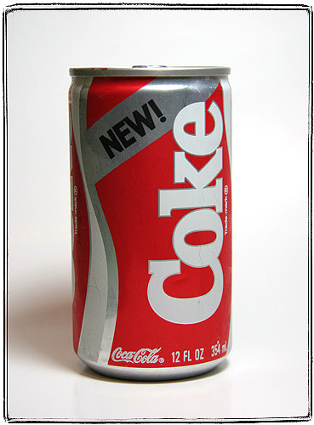
New Coke
New Coke replaced Coke Classic for 79 days in 1985!
Public outcry quickly brings back Coke Classic.
Sergio Zyman was in charge of marketing New Coke. Even after this colossal failure, Coke brought Zyman back and made him director of marketing. Roberto Goizueta, CEO at the time said, “We became uncompetitive by not being tolerant of mistakes. The moment you let avoiding failure become your motivator, you’re down the path of inactivity.” Fortune, 5/1/95
Chairman and CEO Neville Isdell at a more recent annual meeting: “Innovation is vital. You will see some failures. As we take more risks, this is something we must accept as part of the regeneration process.” Business Week 7/10/06

Slide 24
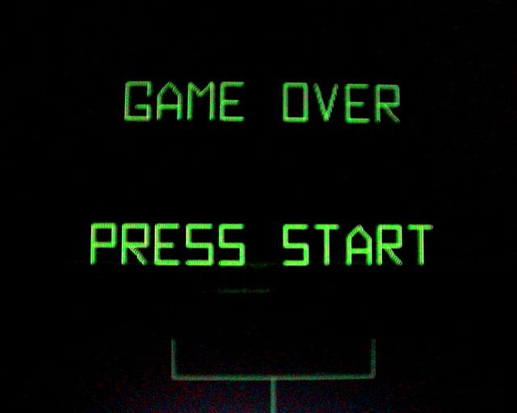
Gaming and Failure

Slide 25
What does gaming have to do with failure and leadership?
“Attitudes toward success and failure are a fault line dividing generations. These new workers realize –as a few thoughtful people always have- that pursuing success is like chasing the horizon, and that failure is an integral part of an interesting life.”
Whoever Makes the Most Mistakes Wins
“…video games create what the psychologist Eric Erickson has called a psychosocial moratorium-that is, a learning space in which the learner can take risks where real-world consequences are lowered. After all, you can save the game and start back at the save point when you fail”
What Video Games Have to Teach Us About Literacy and Learning

Slide 26
So What??
Important implications for managing millenials (student workers, younger new hires)
It’s not only the gamers that have begun to internalize these ideas: active learning styles
They see mistakes as a natural part of the process
Gamers make good problem solvers(?)
They don’t like manuals and detailed procedures
Learn new applications/software quickly
Can be good innovators IF allowed some failures

Slide 27
So, how do I nurture failure?
Failing Backward | Failing Forward
Blaming others | Taking responsibility
Repeating the same mistakes | Learning from each mistake
Expecting never to fail again | Knowing failure is part of progress
Expecting to fail continually | Making a positive attitude
Accepting tradition blindly | Challenging outdated assumptions
Being limited by past mistakes | Taking new risks
Thinking I am a failure | Believing something just didn’t work
Quitting | Persevering
From: Failing Forward: Turning Mistakes into Stepping Stones for Success
By: John Maxwell

Slide 28
Nurturing Failure
Cultivate a risk and failure tolerant culture
  “A 1989 study of 114 interns and residents … found that almost half of the physicians-in-training neither informed nor discussed their most serious errors with their supervising doctors.” Do It Right the First Time. Gerard Nierenberg
Encourage wild ideas during brainstorming sessions.
Spend more time listening (“Manage as if you have no power”)
Think about evaluation timelines. To encourage risk-taking and innovation some corporations use a 3 year review in addition to an annual review.

Slide 29
Nurturing Failure
Try new things (but don’t stop assessing)
Lighten up and have more fun in the library! There’s a reason people ride scooters around Google’s offices!
Openly acknowledge and examine failures to see what can be learned.

Slide 30
Nurturing Failure
To encourage innovation practice “Zen Mind”. Beginner’s mind is the open mind, the attitude that includes both doubt and possibility, the ability to see things always as fresh and new.
Hire a diverse staff and create diverse inter-departmental teams (including students) for important projects.
  Rochester study (anthropologist in the library) is a great example

Slide 31

You idiot, this is a recipe for chaos!
How do you safeguard success while nurturing failure?
Use chat box to toss out some ideas.

Slide 32
Safeguarding Success
“Encouragement of failure doesn’t mean the abandonment of supervision, quality control, or respect for sound practices” (Farson)
Whatever new and innovative ideas you try, don’t stop assessing. Give it a chance, but show me the data!
Practice Enlightened Trial and Error: “A half-hearted, careless effort with lame results is inexcusable. A deliberate, well-thought-out effort that didn’t succeed isn’t. That type of failure is not only excusable, but desirable.” (Farson)

Slide 33
Safeguarding Success
Mistakes are acceptable, repeating them is not.
All workplaces need innovators and worker bees. Clearly identify who is who.
Don’t start nurturing failure without buy-in from the higher-ups (if not buy-in, at least be sure they are thoroughly informed!)
Continue to require documented progress on projects.

Slide 34
Failure and Libraries
Leigh Anne Vrabel on Library Alchemy Blog:
“Failure,” in the context of library work, is an amusing intellectual concept because, even on our very worst days nobody dies (usually) and nothing gets set on fire (normally).
OMG I am such an idiot! My boss is going to kill me. Worse, before s/he kills me, s/he’s going to give me THAT LOOK, the one that makes me want to curl up and die of shame because it reminds me of the way my swimming teacher looked at me when I refused to jump off the high dive in 4th grade PE. Maybe Boss will yell, or maybe s/he’ll give me the silent treatment, but either way, this blunder is going to go down in my PERMANENT LIBRARY RECORD, and I will never get another good assignment, promotion, or raise ever again. I’ll stop getting invited to the GOOD meetings, the ones with DOUGHNUTS. People will avoid me in the halls and stop talking whenever I walk into a room, and it will be because they were discussing ME and ALL THE WAYS IN WHICH I AM AN EPIC FAILURE.
http://libraryalchemy.wordpress.com/2010/03/29/title-fail-insert-vampire-metaphor-here-library-failure-pt-i/

Slide 35
Failure and Libraries
Meredith Farkas: “Information Wants to Be Free” Blog:
“We should write about and celebrate our failures. We should brainstorm with others and figure out what we could have/should have done differently so that we’ll do better next time. When we’re embarrassed about our failures or sweep them under the rug, we’re depriving ourselves and others of a valuable learning experience.”
http://meredith.wolfwater.com/wordpress/2007/12/16/sharing-the-bad-stuff-learning-from-failures/

Slide 36
Is the idea of nurturing failure idealistic?
Use chat box to answer.
On the contrary, I think it is incredibly realistic.
We all make mistakes. No one succeeds 100% of the time.
Isn’t the idea of 100% success, win at all costs idealistic (and blatantly impractical)?

Slide 37
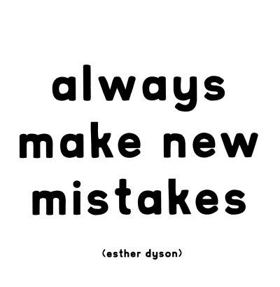

Slide 38
Questions?
Chris Sweet
csweet@iwu.edu

