Slide 1
The Undergraduate in the Repository:
Connecting the Dots
Key to Unlocking Scholarship: Institutional Repositories
University of Kentucky Libraries
Stephanie Davis-Kahl
The Ames Library, Illinois Wesleyan University
November 11, 2011

Slide 2

Notes:
Ultimately, my undergraduate is your future graduate student and our future faculty, administrators, librarians, doctors, lawyers, teachers, social workers. My goal is to make sure they arrive on your doorstep with an understanding of why open access and public access matters.

Slide 3
Where will you go from here?

Slide 4
Intellectual Entrepreneurship
“The aim of Intellectual Entrepreneurs is to educate “citizen-scholars” – individuals who own and are accountable for their education and who utilize their intellectual assets to add to disciplinary knowledge and as a lever for social good.”
Professor Richard Cherwitz, 2000
(emphasis mine)
Notes:
Think about the repository in this light, in this frame
How can the repository help develop citizen/scholars?

Slide 5
Capstone Publishing Experience: Undergraduate Economic Review

Slide 6

Roles & Responsibilities

Slide 7
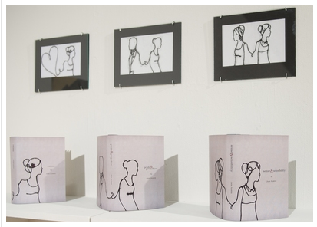

John Wesley Powell Undergraduate Research Conference: Art & Music
Jane Austen Book Covers, Jamie Kang
Fast Monsters, Victoria Poll

Slide 8
Integration into Instruction
Building a toolkit:
  Familiarize students with the concepts of Open Access and Public Access,
  Introduce both general and discipline-specific scholarly resources to them that they will have access to post-graduation
  Reinforce concepts of peer review and credibility
Discipline-focused OA resources
Faculty outreach

Slide 10
Campus Connections
Student Scholarly & Creative Work
Community Engagement
Faculty Work and Beyond
Faculty Governance
Digital Commons
@ IWU
Admissions, Alumni Relations
University Communication
Information Literacy Instruction
Archives & Special Collections

Slide 11
Where will you go from here?

Slide 12

Thanks
Stephanie Davis-Kahl
Scholarly Communications Librarian
The Ames Library
sdaviska@iwu.edu
Digital Commons @ IWU
http://digitalcommons.iwu.edu

